Slide 1

8th Grade Math: Pre-Algebra
Unit 4, Lesson 8 Applying Exponent Laws to Algebraic Expressions – Part 2 Volume 1, pg. 157

Slide 2


Benchmark
MA.8.AR.1.1
Apply the Laws of Exponents to generate equivalent algebraic expressions, limited to integer exponents and monomial bases.
volume 1, pg. 157

Slide 3
Integrated Mathematical Thinking and Reasoning Standards
MA.K12.MTR.2.1 Demonstrate understanding by representing problems in multiple ways.
MA.K12.MTR.3.1 Complete tasks with mathematical fluency.
MA.K12.MTR.4.1 Engage in discussions that reflect on the mathematical thinking of self and others.
MA.K12.MTR.5.1 Use patterns and structure to help understand and connect mathematical concepts.
volume 1, pg. 157

Slide 4

Learning Target
I can write an equivalent expression by applying quotient of powers or power of a quotient laws of exponents.
volume 1, pg. 157

Slide 5

Warm-Up
volume 1, pg. 158

Slide 6
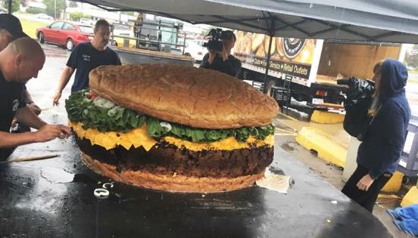
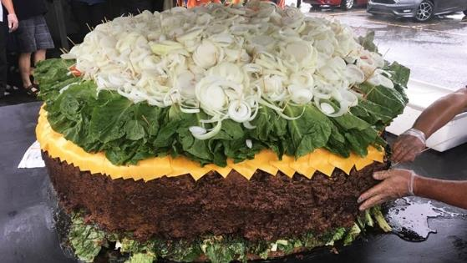
4.8.1 Warm-Up: Notice and Wonder
The world’s largest burger belongs to Mallie’s Sports Grill and Bar in Detroit and it costs $\$8,000$.
What do you wonder about the world’s largest burger?
Write a math problem that could be solved using the world’s largest hamburger.
volume 1, pg. 158
Notes:
Video Link: https://algebranation.wistia.com/medias/fi4fidi5y8

Slide 7

Guided Instruction
volume 1, pg. 158

Slide 8
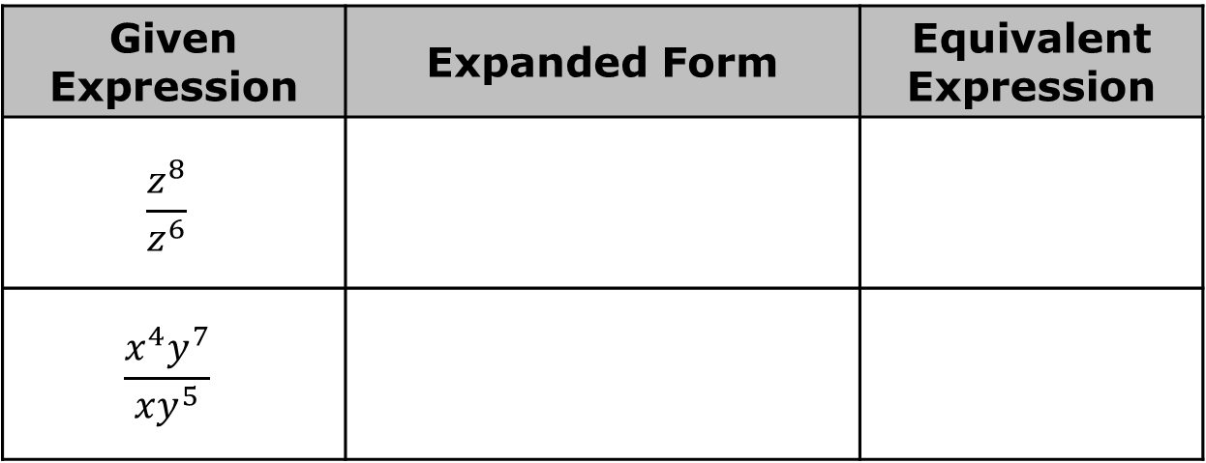
4.8.2 Guided Instruction: Equivalent Algebraic Expressions Involving Division
For each expression, rewrite the expression in expanded form. Then, write an equivalent algebraic expression using the fewest possible variable bases.
Given Expression | Expanded Form | Equivalent Expression
$$\frac{z^{8}}{z^{6}}$$
$$\frac{x^{4}y^{7}}{xy^{5}}$$
volume 1, pg. 158

Slide 9
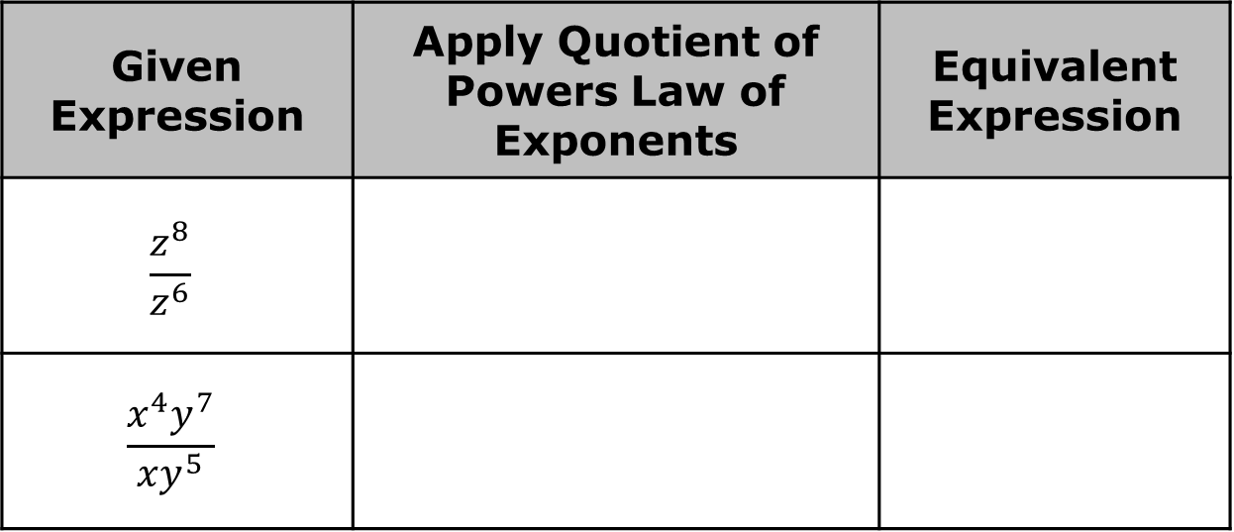
Show how each of the equivalent expressions could have been generated by applying the quotient of powers law of exponents.
Given Expression | Apply Quotient of Powers Law of Exponents | Equivalent Expression
$$\frac{z^{8}}{z^{6}}$$
$$\frac{x^{4}y^{7}}{xy^{5}}$$
The quotient of powers law of exponents can be applied to generate equivalent expressions involving division with algebraic expressions.
volume 1, pg. 158

Slide 10
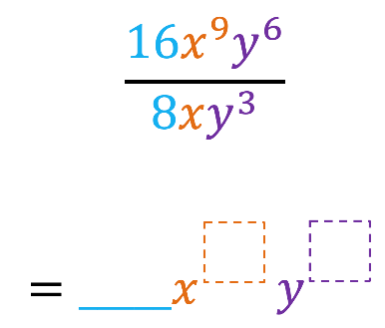
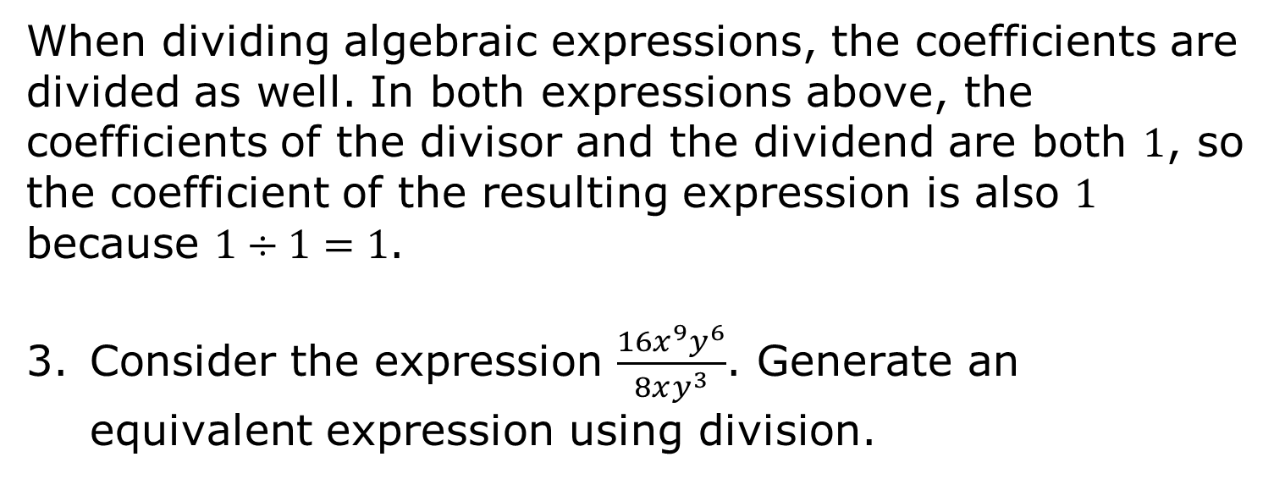
When dividing algebraic expressions, the coefficients are divided as well. In both expressions above, the coefficients of the divisor and the dividend are both $1$, so the coefficient of the resulting expression is also $1$ because $1÷1=1$.
Consider the expression $\frac{{16x}^{9}y^{6}}{8xy^{3}}$. Generate an equivalent expression using division.
volume 1, pg. 159

Slide 11
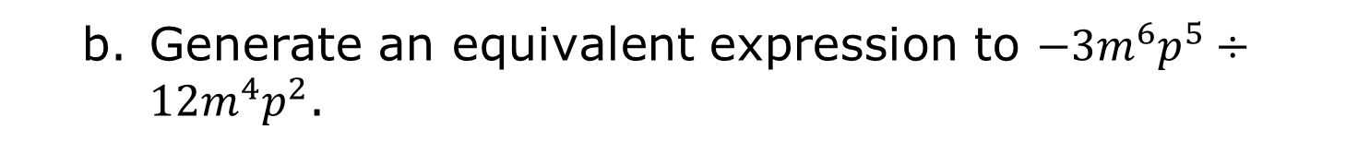
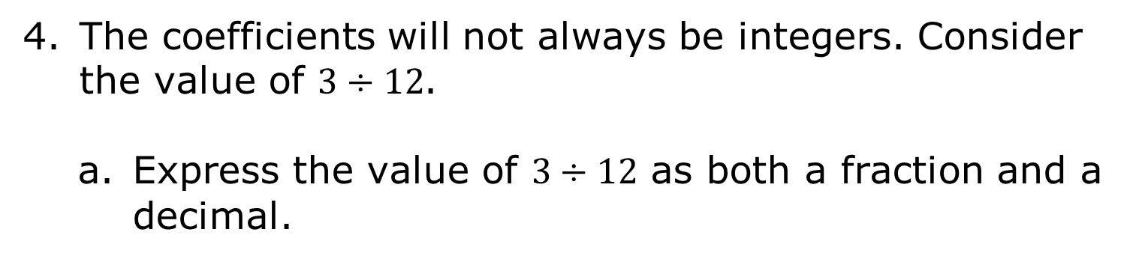
The coefficients will not always be integers. Consider the value of $3÷12$.
Express the value of $3÷12$ as both a fraction and a decimal.
Fraction
Decimal
Generate an equivalent expression to $−3m^{6}p^{5}÷12m^{4}p^{2}$.
volume 1, pg. 159

Slide 12
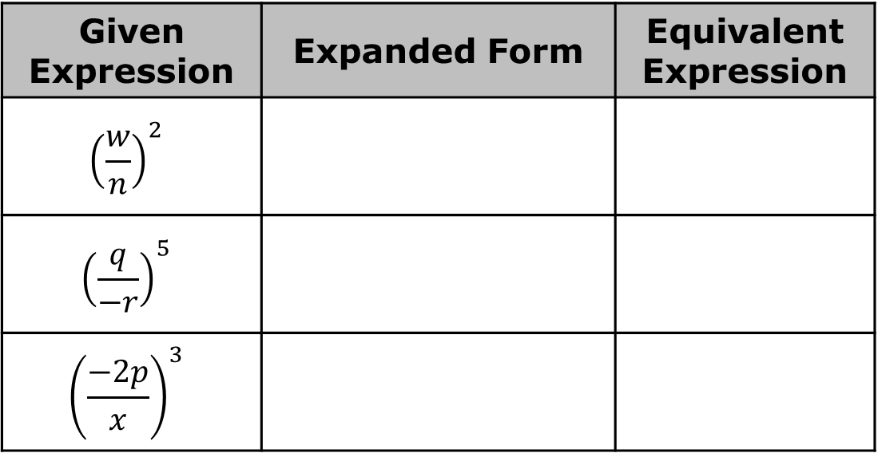
Consider the expressions in the table.
For each expression, rewrite the expression in expanded form. Then, write an equivalent algebraic expression using the fewest possible variable bases.
Given Expression | Expanded Form | Equivalent Expression
$${\left(\frac{w}{n}\right)}^{2}$$
$${\left(\frac{q}{−r}\right)}^{5}$$
$${\left(\frac{−2p}{x}\right)}^{3}$$
volume 1, pg. 159

Slide 13
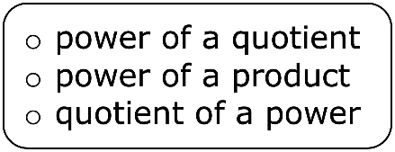
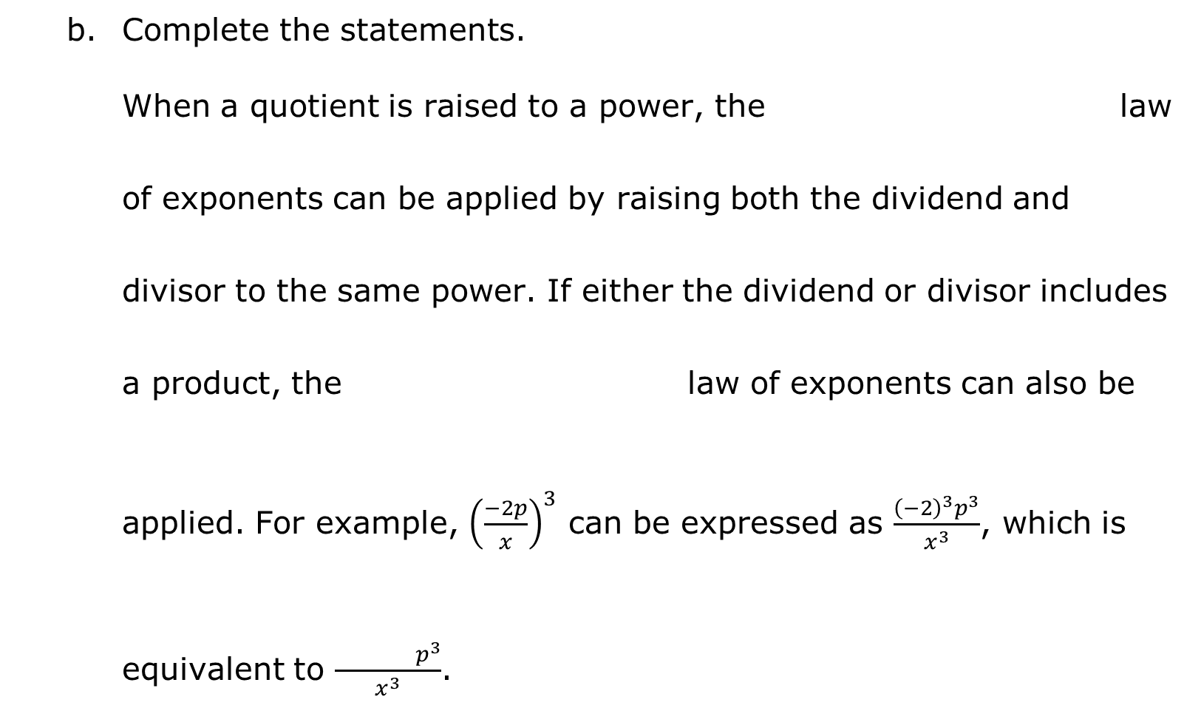
Complete the statements.
When a quotient is raised to a power, the law of exponents can be applied by raising both the dividend and divisor to the same power. If either the dividend or divisor includes a product, the law of exponents can also be applied. For example, ${\left(\frac{−2p}{x}\right)}^{3}$ can be expressed as $\frac{{\left(−2\right)}^{3}p^{3}}{x^{3}}$, which is equivalent to $\frac{ p^{3}}{x^{3}}$.
volume 1, pg. 159

Slide 14

Try It
volume 1, pg. 160

Slide 15
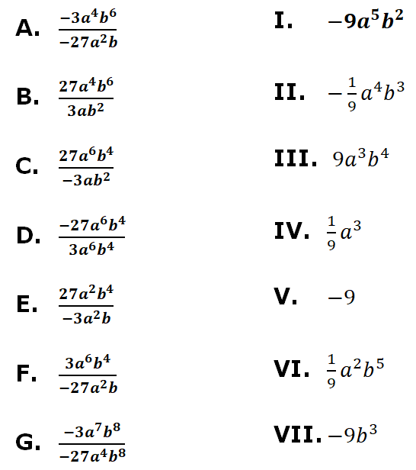
4.8.3 Try It: Equivalent Algebraic Expressions Involving Division
Match the expressions in the column on the left to an equivalent expression in the column on the right by drawing arrows.
volume 1, pg. 160

Slide 16

Your Turn
volume 1, pg. 160

Slide 17
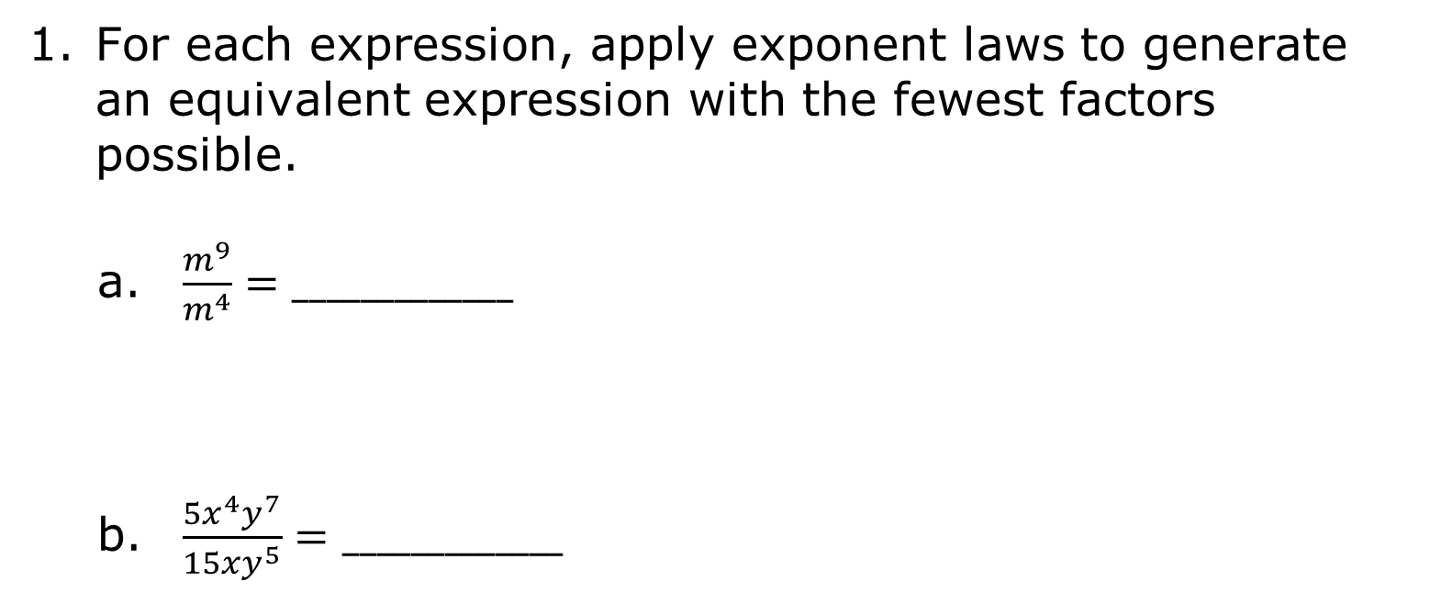
4.8.4 Your Turn!
For each expression, apply exponent laws to generate an equivalent expression with the fewest factors possible.
$\frac{m^{9}}{m^{4}}=_____________$
$\frac{5x^{4}y^{7}}{15xy^{5}}=_____________$
volume 1, pg. 160

Slide 18

$\frac{{−21c}^{5}d^{6}}{{7c}^{4}d^{2}}=_____________$
${\left(\frac{z}{2}\right)}^{3}=_____________$
${\left(\frac{f}{g}\right)}^{8}=_____________$
$\frac{a^{7}b^{9}}{a^{6}b}=_____________$
volume 1, pg. 160

Slide 19

Wrap-Up
volume 1, pg. 161

Slide 20
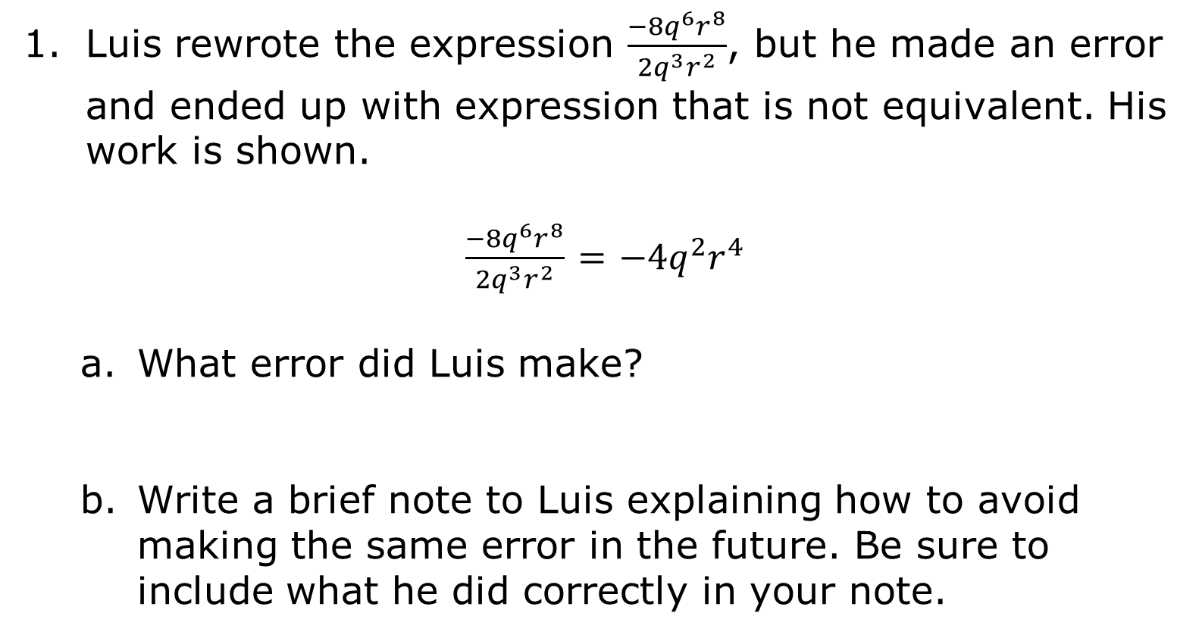
4.8.5 Wrap-Up: Error Analysis
Luis rewrote the expression $\frac{{−8q}^{6}r^{8}}{{2q}^{3}r^{2}}$, but he made an error and ended up with expression that is not equivalent. His work is shown.
$\frac{{−8q}^{6}r^{8}}{{2q}^{3}r^{2}}$ $=$ $−4q^{2}r^{4}$
What error did Luis make?
Write a brief note to Luis explaining how to avoid making the same error in the future. Be sure to include what he did correctly in your note.
volume 1, pg. 161

